Slide 1
Introduction and Overview Traditional Algorithms vs ML
Understanding Machine Learning

Slide 2
goals of this course
understanding of foundational ML concepts and commonalities between different methods
ability to properly use ML for scientific or business problems
schedule of lectures
introduction and overview
statistical learning
non-linear models
generalization
deep learning
transformers
generative models
causality
reinforcement learning

Slide 3
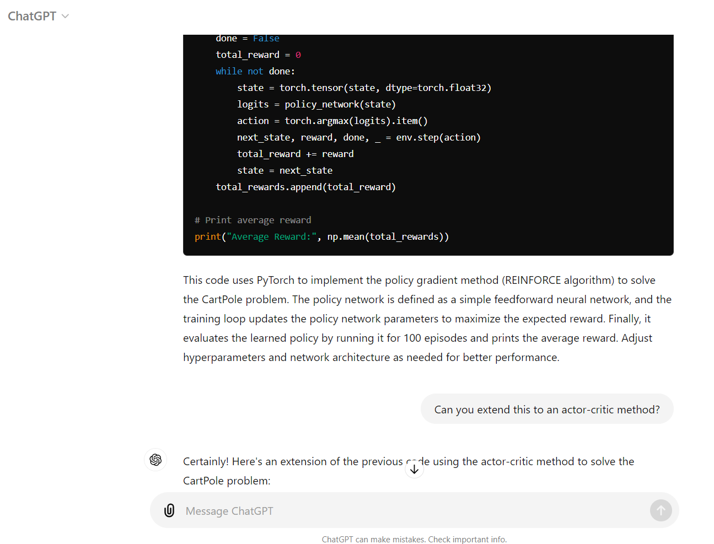


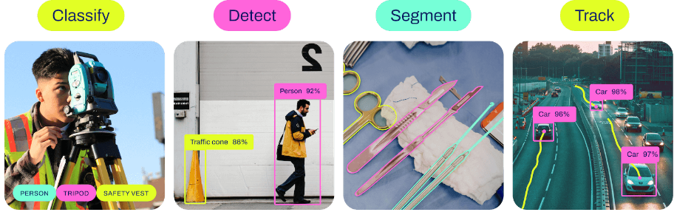
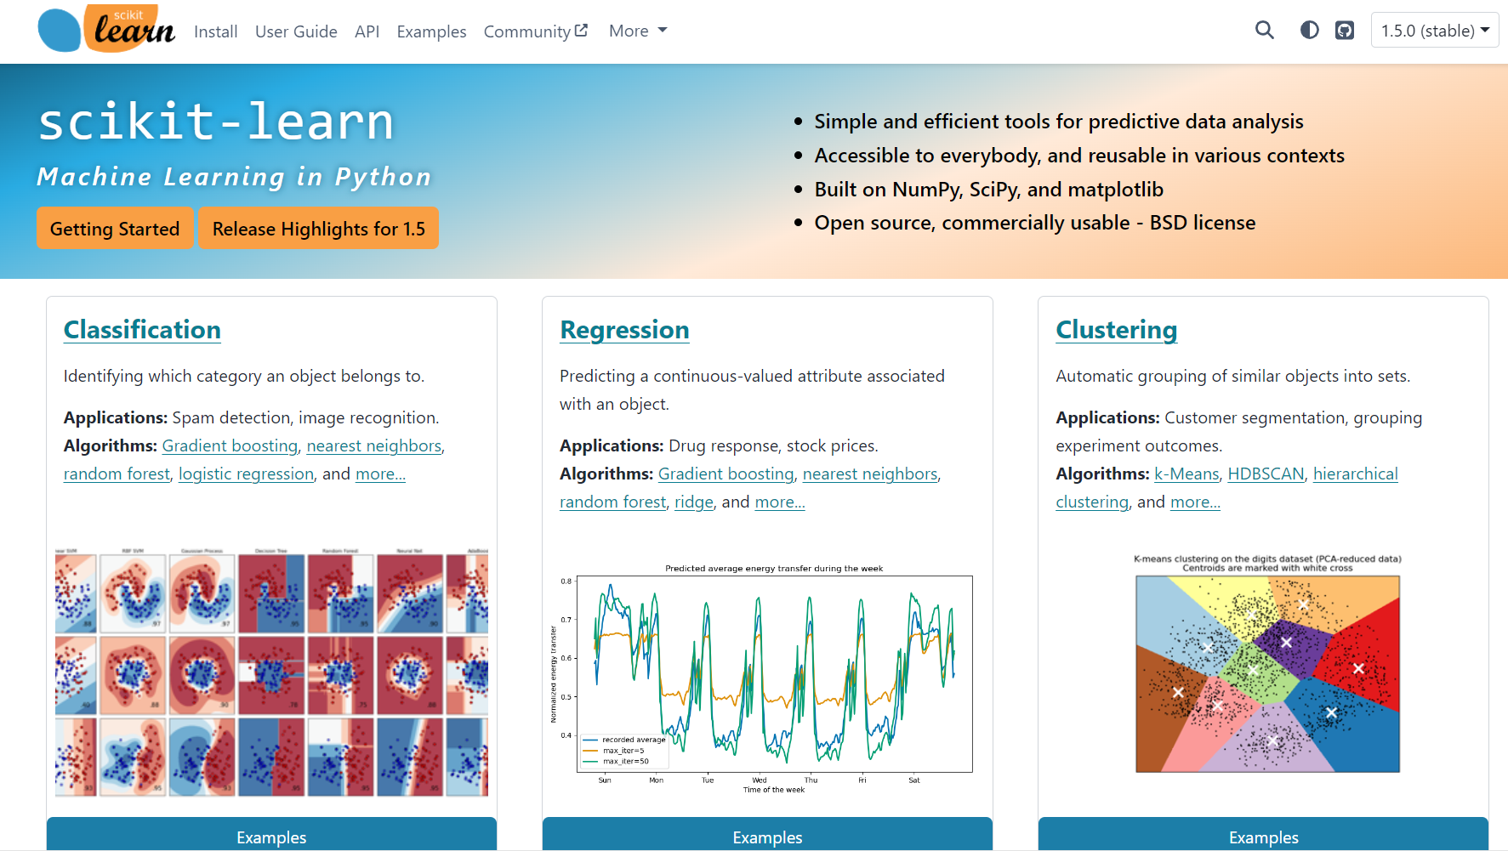

Classic ML vs Deep Learning
Generative vs Predictive Models
text generation
image synthesis
text-to-video
ChatGPT
Stable Diffusion 3 — Stability AI
Sora | OpenAI
BERT family
tabular data
computer vision
YOLO

Slide 4
AI/ML Overview

Slide 5
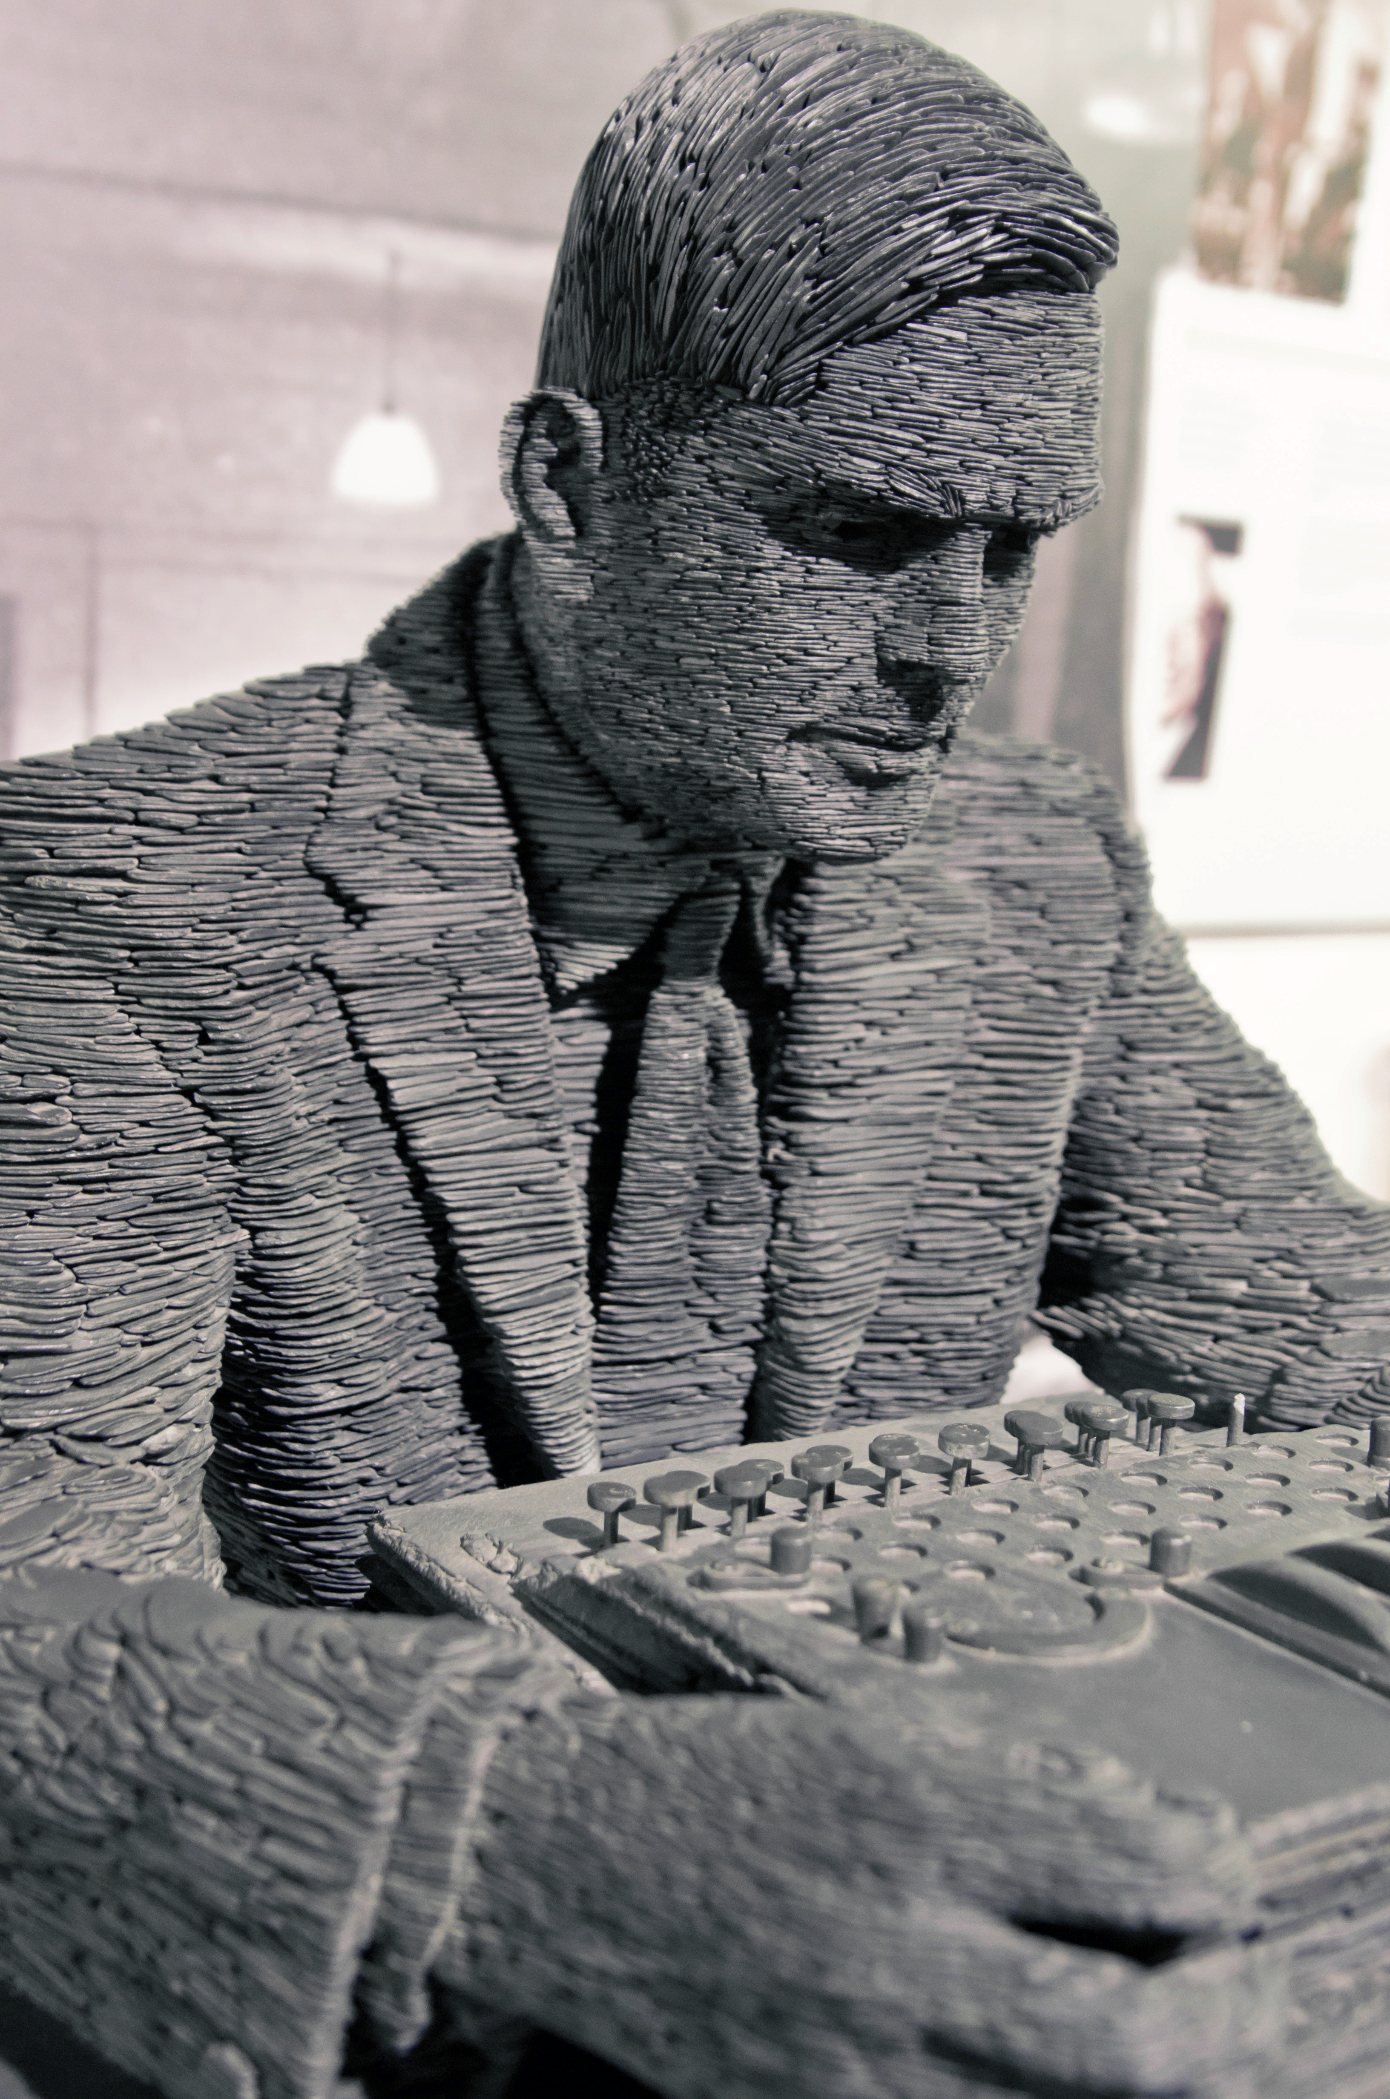
Main Areas of Artificial Intelligence
computer vision
(spatial structures, state-of-the-art: Convolutional Neural Networks)
natural language processing
(sequential structures, state-of-the-art: transformers)
automated decision making, robotics
(reinforcement learning)
All of these are enabled by one key ingredient:
learning from experience (Machine Learning)
also: knowledge representation, automated reasoning (first indices in modern Large Language Models)
from wikipedia
agency:
perception – thought – action
from Artificial Intelligence: A Modern Approach (Russell, Norvig)

Slide 6
Buzz Words …
blend of diverse components from different domains (statistics, optimization, computer science, …)
Artificial Intelligence
Deep Learning:
special kind of ML algorithms using (deep) neural networks
Data Science:
extract knowledge from data (by means of ML, among other things)
Machine Learning
Deep
Learning
Data Science

Slide 7
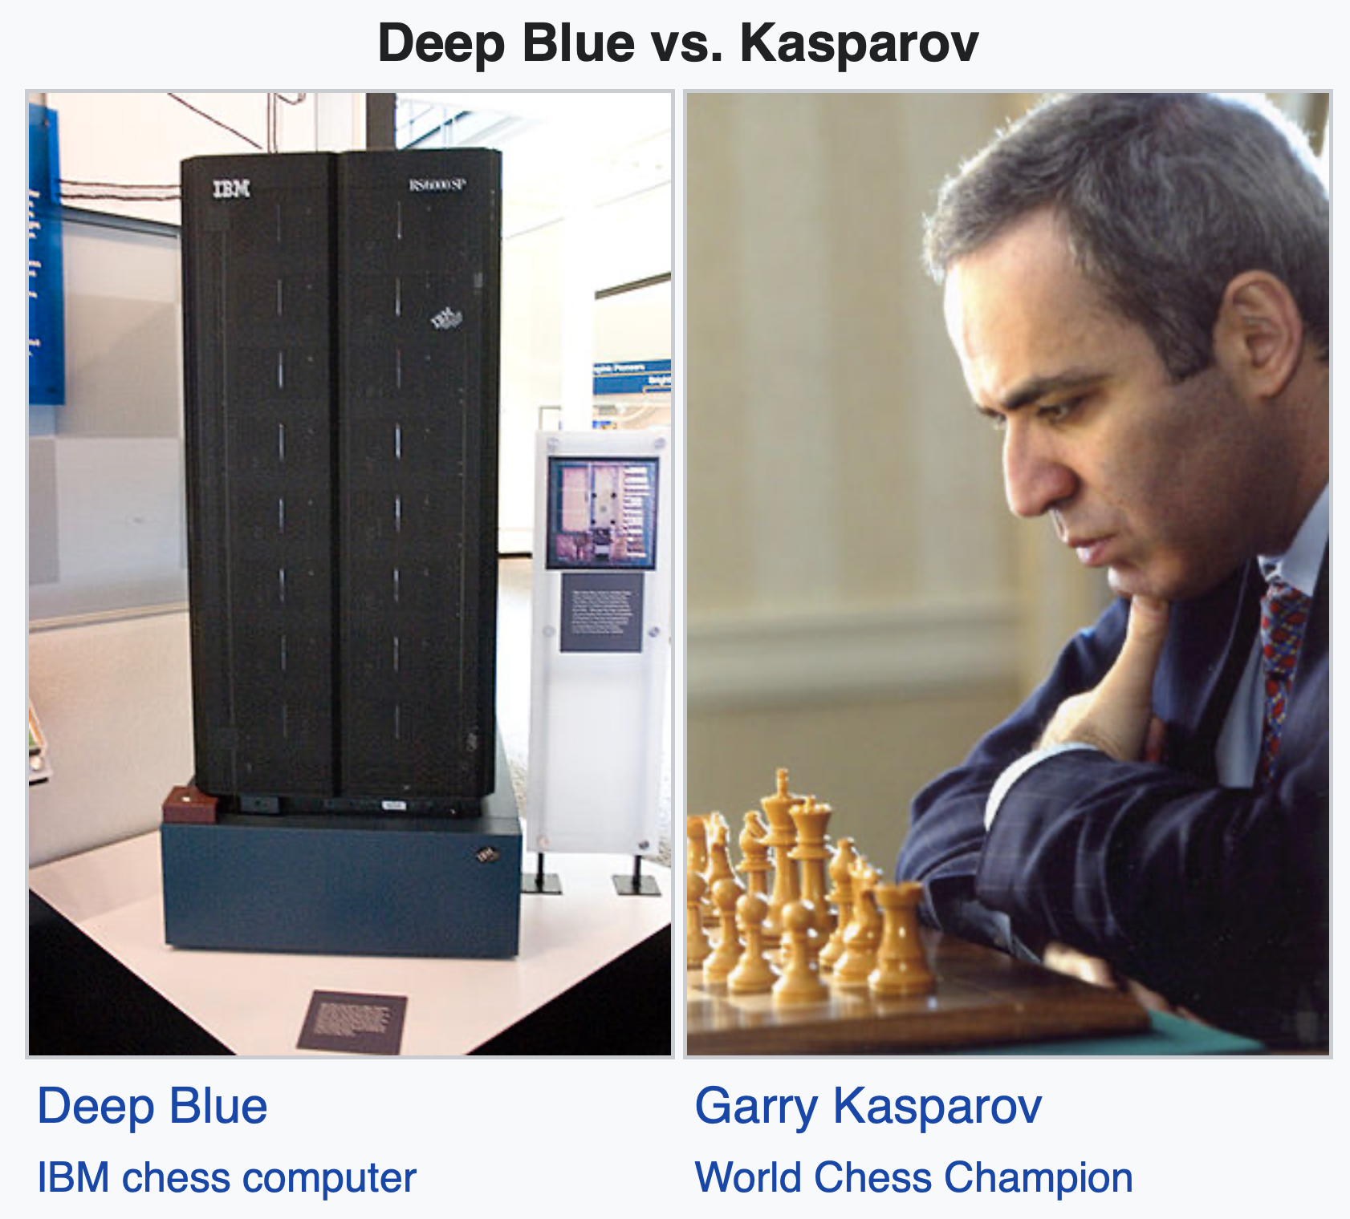
Traditional Algorithms and GOFAI
traditional algorithms:
explicit (handcrafted) instructions for each situation
symbolic AI (aka GOFAI):
use knowledge by means of symbols (as representations), logic, search (e.g., expert systems like Deep Blue)
Public perception is changing over time: A modern chess program, nowadays disparaged as brute computing, would have been considered intelligent in the 50s.
from wikipedia

Slide 8
ML: Learning from Experience/Data
mainly exploiting statistical dependencies with the aim of generalization to new (e.g., future) data (compare with human reasoning by analogies)
training (usually offline optimization):
ML algorithm + data = explicit algorithm (to be used at inference time)
reduction of complexity and much better generalizability compared to handcrafted algorithms
analogy: Humans do not hit the ground running (storage capacity of DNA limited) but have learning capabilities.

Slide 9
Hot Debate: Connectionism vs Symbolic AI
connectionists:
learn from (big) data without prior knowledge
symbolists:
use knowledge with only modest input data
(crude) analogy: learning and evolution
philosophical: empiricist and rationalist schools of mind
hybrid approaches often most successful (feature engineering for ML models also kind of symbolic knowledge representation)

Slide 10
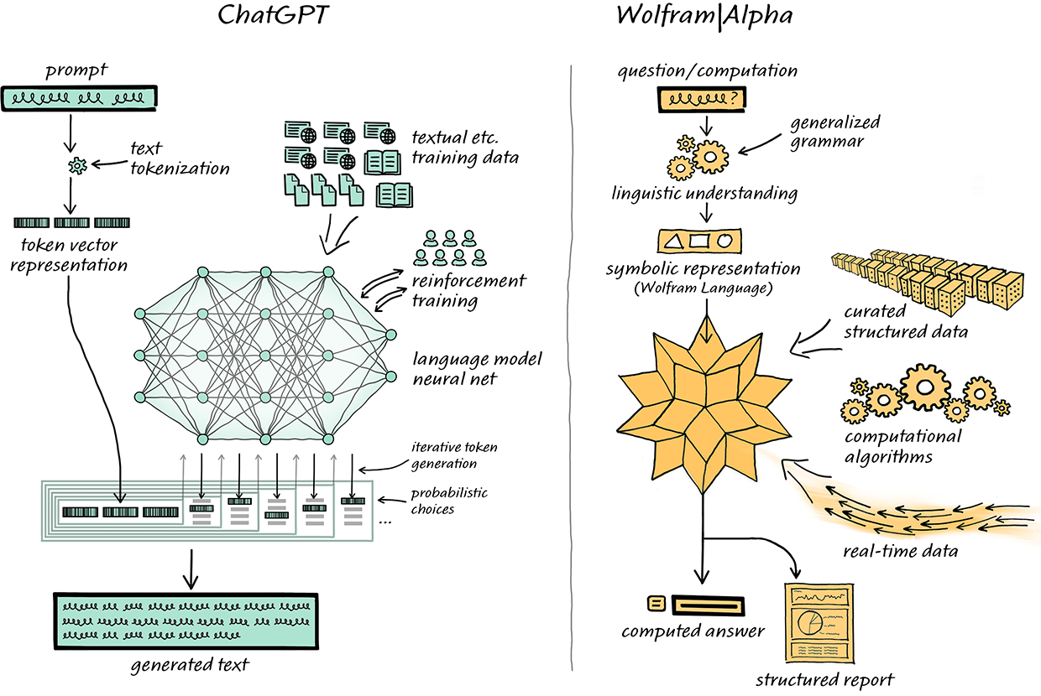
Hybrid Approach for Language Models?
AlphaGeometry
tool usage:
LangChain
source

Slide 11
Supercharging the Scientific Method
use ML and data to replace or enhance explicit methods relying on detailed domain knowledge (Software 2.0)
overcome our evolutionary limitations in math with clever learning algorithms and collecting data
immediate impact on many aspects of industry, business, and science, formulated as narrow tasks with strictly defined inputs (aka weak AI)
more imminent than (still philosophical) long-term quest for human-level AI (aka strong AI, AGI), i.e., general-purpose intelligence
(although recent language models show multi-purpose capabilities)

Slide 12








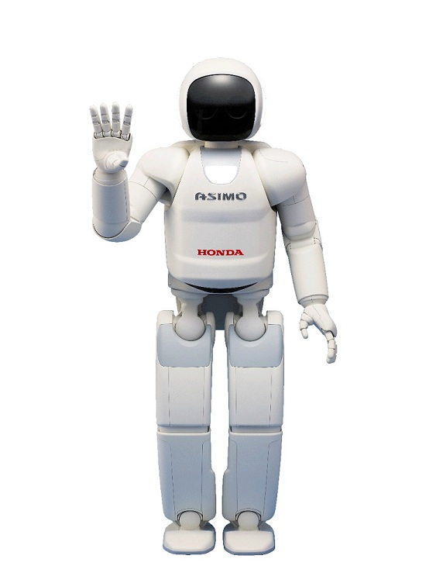





Most Famous Applications
chatbots
autonomous driving
recommendations
translation
robotics
OCR
assistants (speech recognition)
and many more …

Slide 13

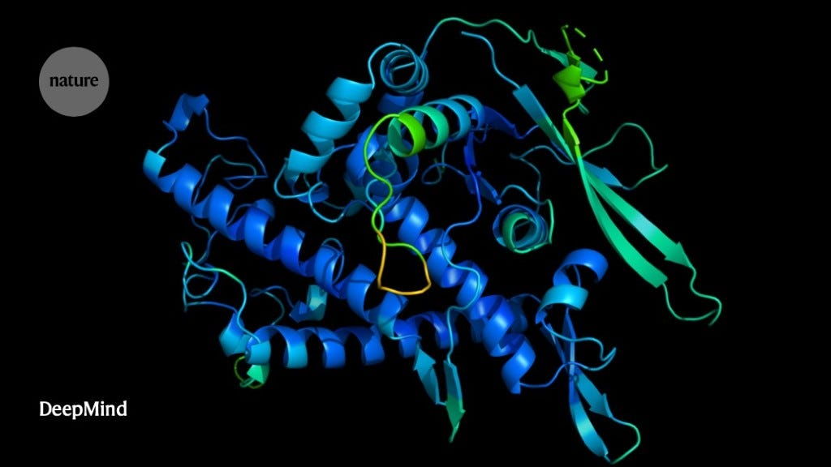
When to Use ML (= Learning from Data)
automation
too complex for rules
complexity / uncertainty
too complex for humans
examples: object recognition, all applications from previous slide
from wikipedia
examples: protein structure predictions (AlphaFold), demand forecasting
more scientific use cases: medicine (imaging, diagnosis, drug design), particle physics (analysis of collider experiments), material science (material properties and design of new materials), …

Slide 14
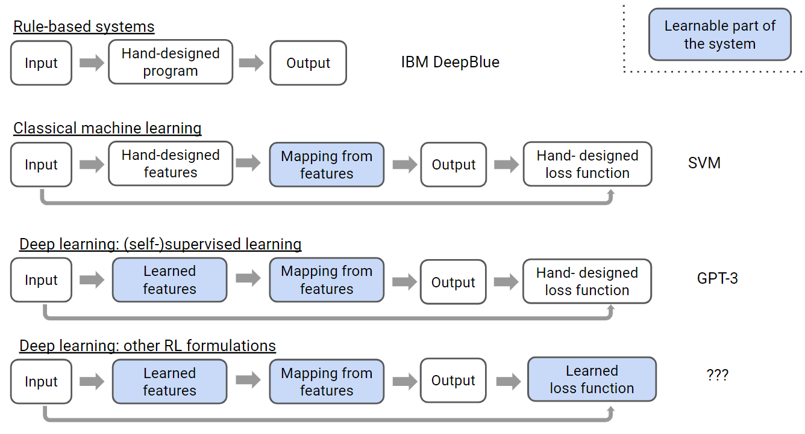
Ladder of Generalization
e.g., ChatGPT (RLHF)
source

Slide 15

Generative AI
example: DALL-E 2
more recently: generative applications
rather than predictive (or discriminative) ones
e.g., image generation, conversational AI, new proteins or materials
Depending on the application, there are currently two dominant approaches:
text generation: large language models (transformer)
image synthesis: diffusion models
up next: video synthesis → dynamics/physics understanding/simulation

Slide 16
Learning Paradigms

Slide 17
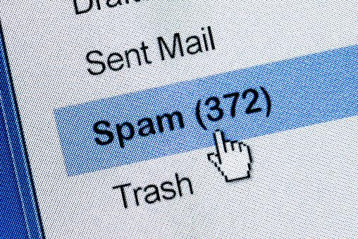
Supervised Learning
learning by teacher → usually rather narrow tasks (passive approach)
Target Quantity
Features
known in training: labeled samples or observations from past
to be predicted for unknown cases (e.g., future values)
input information that is
correlated to target quantity
known at prediction time
Example: Spam Filtering
Classify emails as spam or no spam
use information like occurrence of specific words or email length as features
features x1 and x2 spam, no spam
use accordingly labeled emails as training set

Slide 18
Reinforcement Learning
learning by trial-and-error (exploration and exploitation)
goal-based approach → active and more generic than supervised learning (but sparse reward signals)
receiving feedback from the environment, no supervision
formalization of sequential decision making (delayed rewards)
corresponds to search for best action policy to reach a given goal (e.g., win a game)
using learning from examples (data) to guide the search
RL setup usually more difficult (e.g., non-differentiable as a whole) than supervised learning one
but RL can be cast as supervised-learning setup: express rewards by more intricate loss function

Slide 19
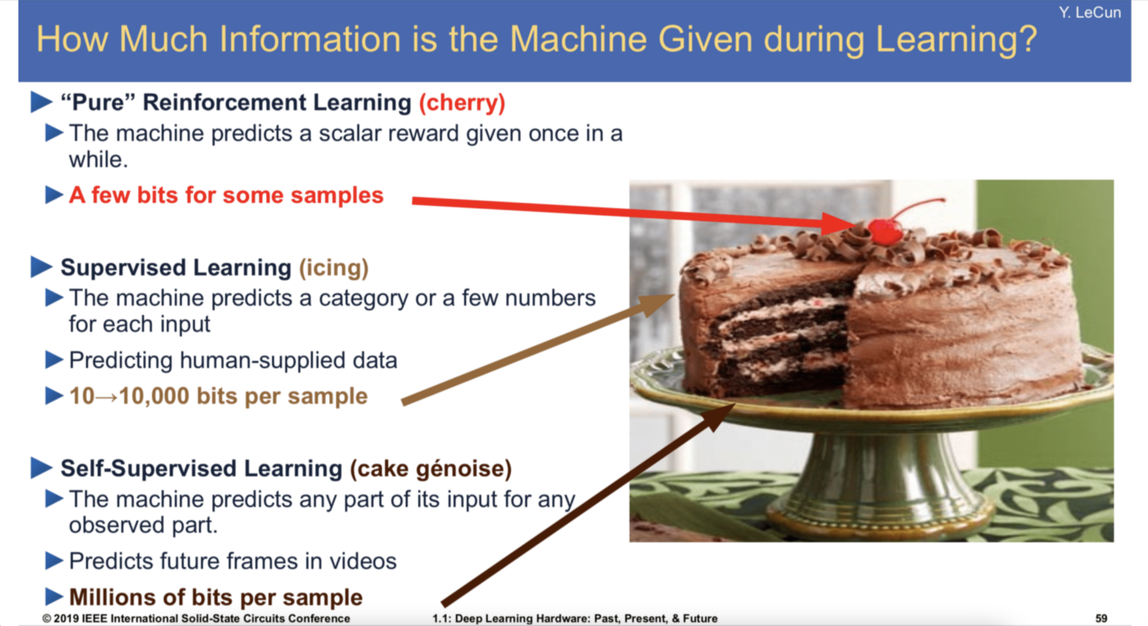
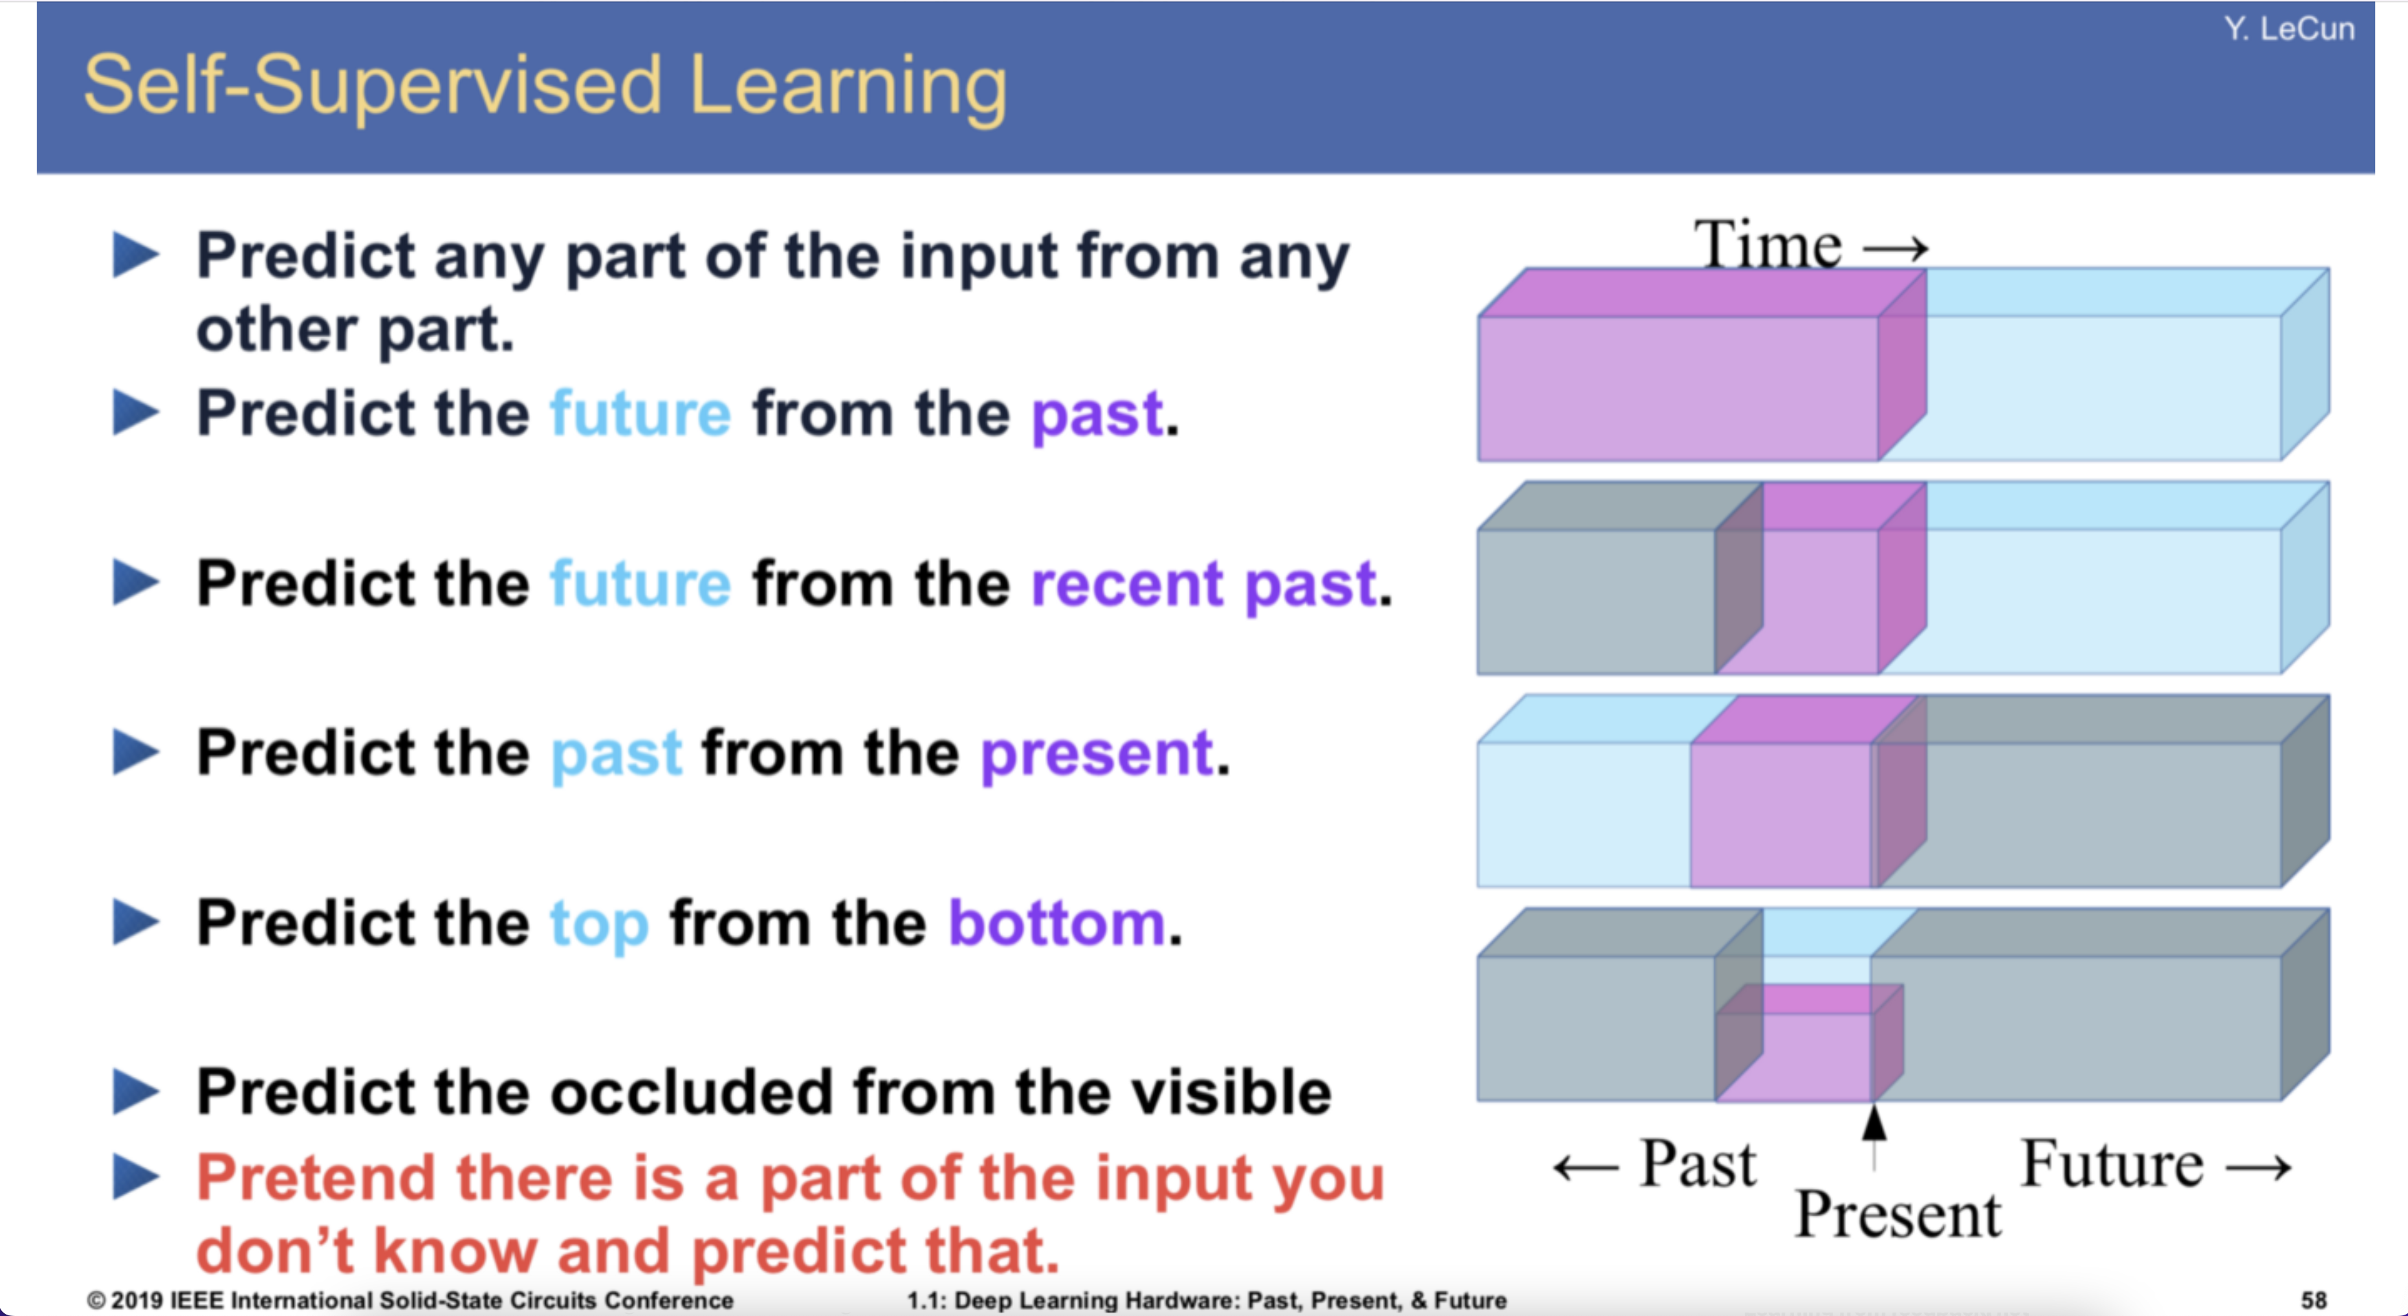
Unsupervised Learning
ML needs lots of training data
learning by observation
no target information → kind of “vague” pattern recognition (but plenty of data)
can be cast as self-supervised learning:
input-output mapping like supervised learning
but generating labels itself from input information
learning of semantic feature representations
e.g., word2vec, BERT, GPT
generative AI as unsupervised learning: generate variations of training data

Slide 20
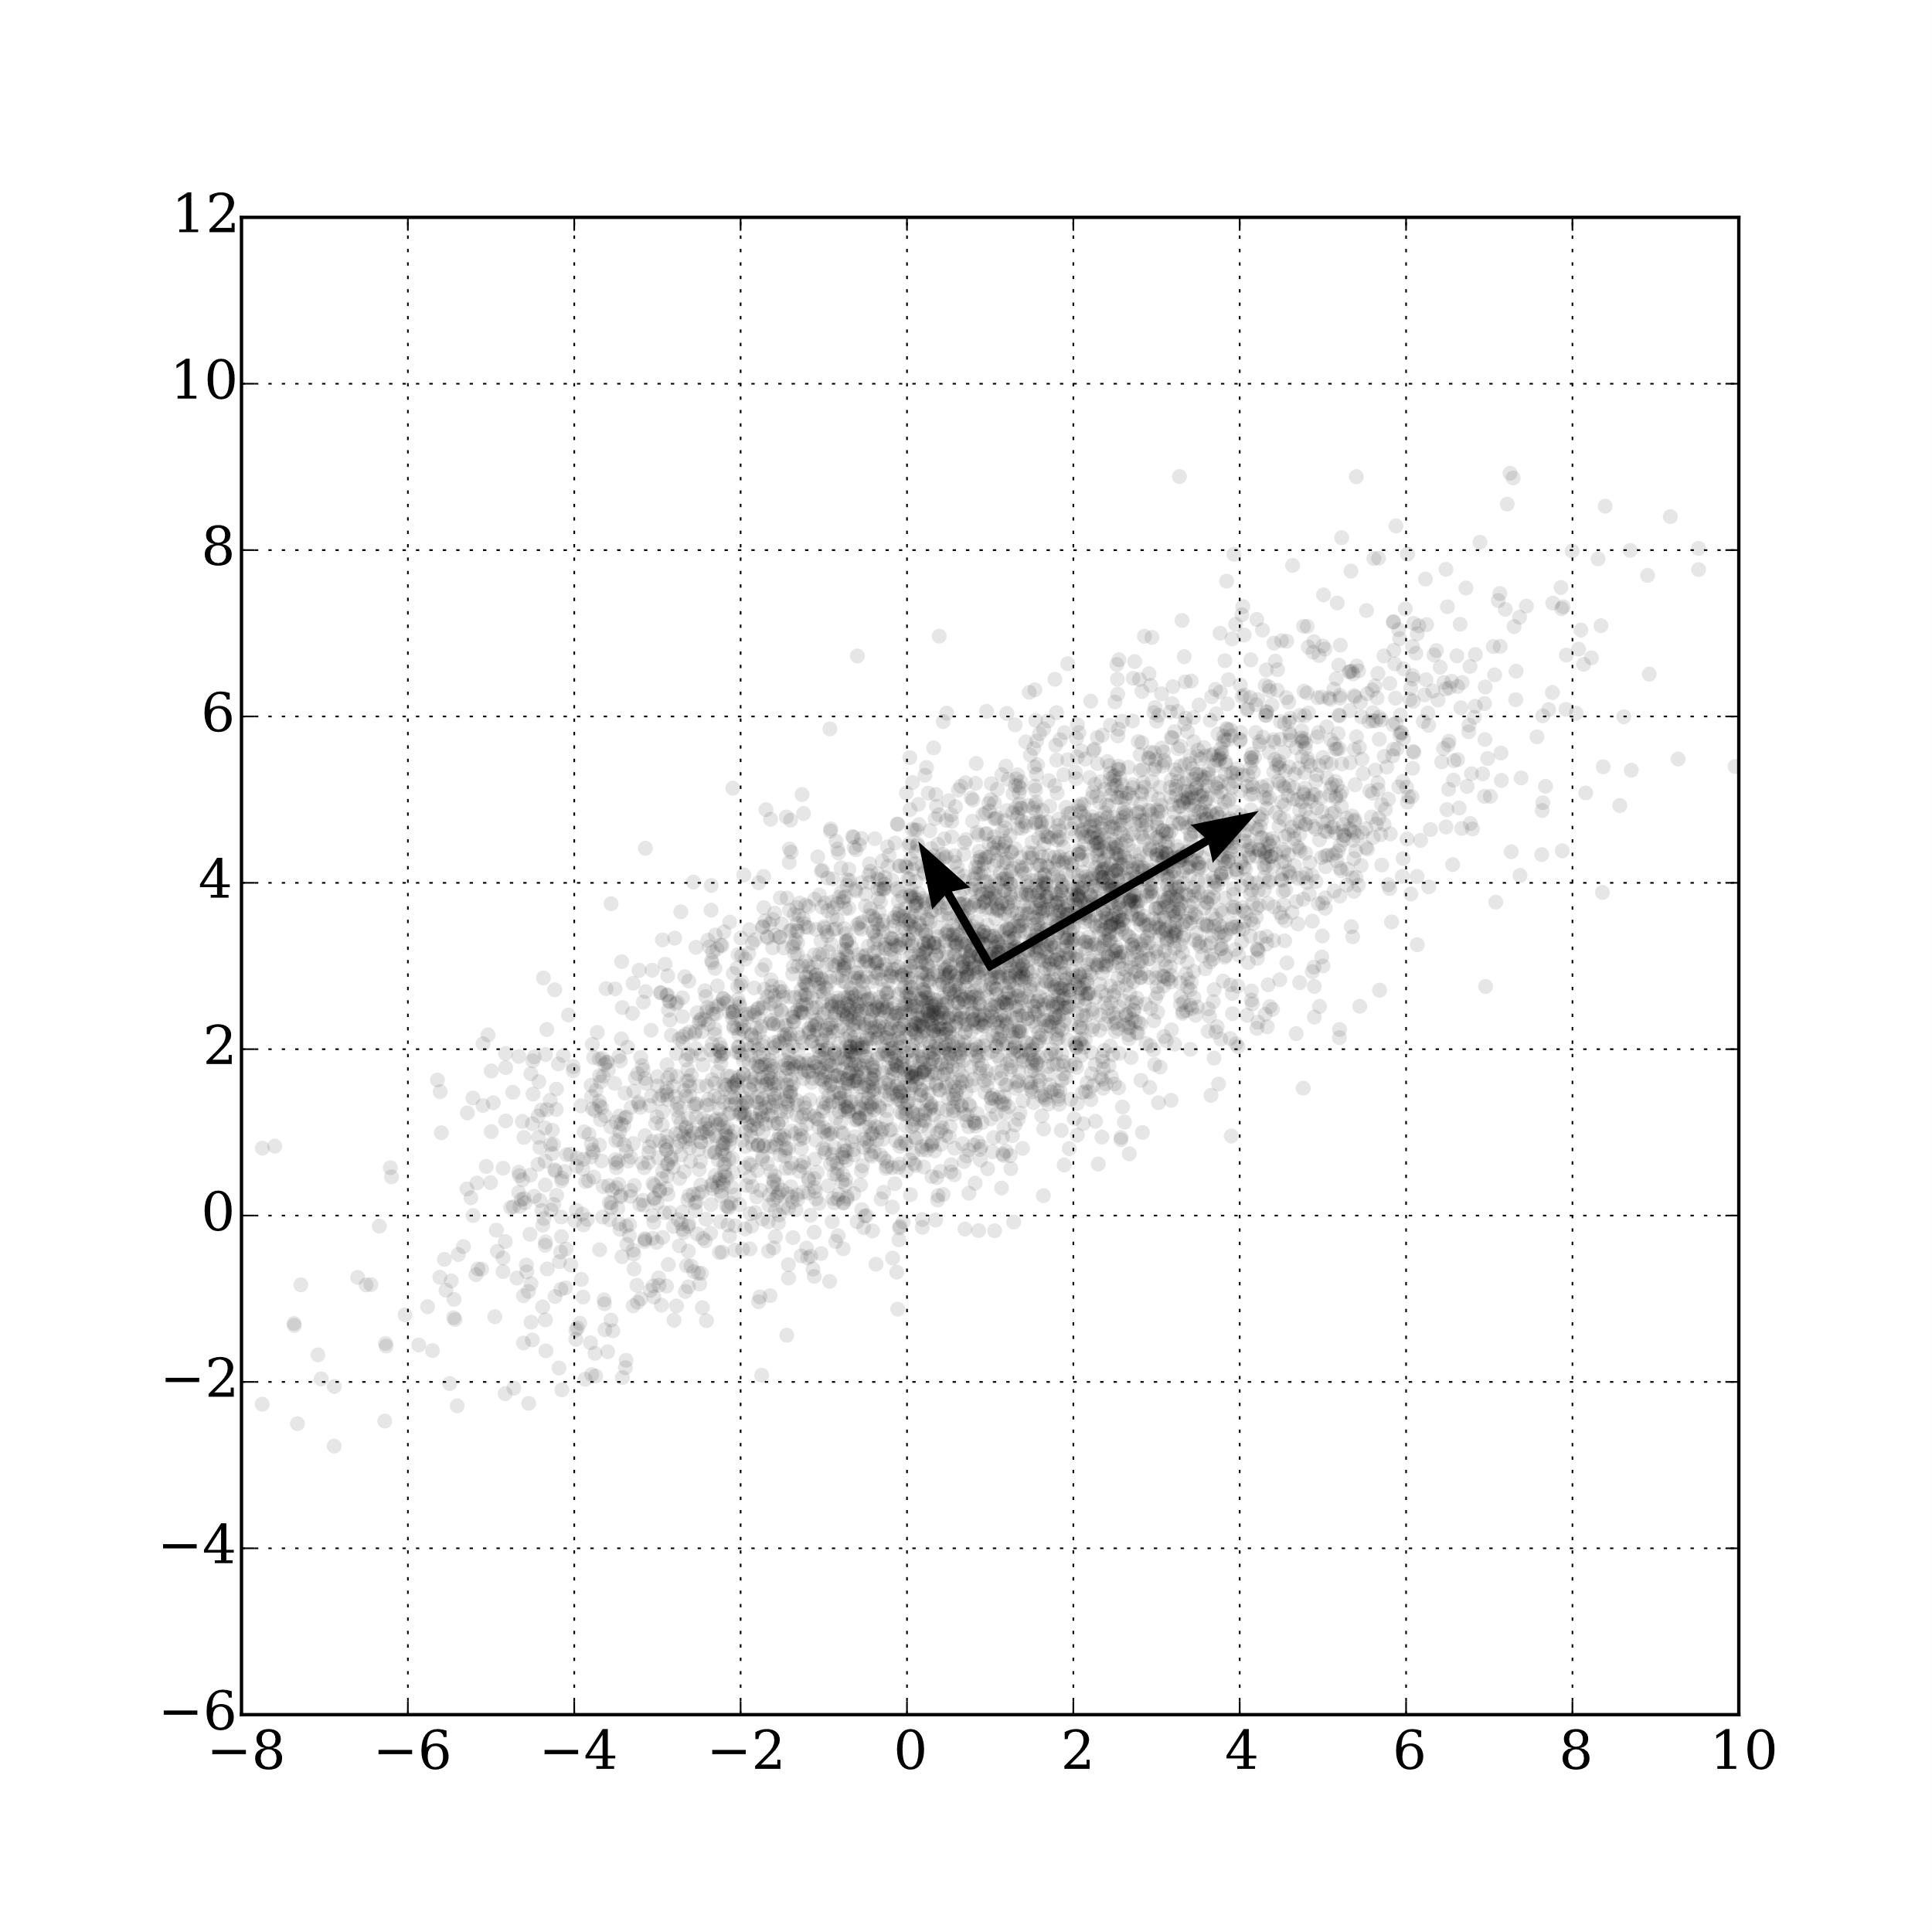
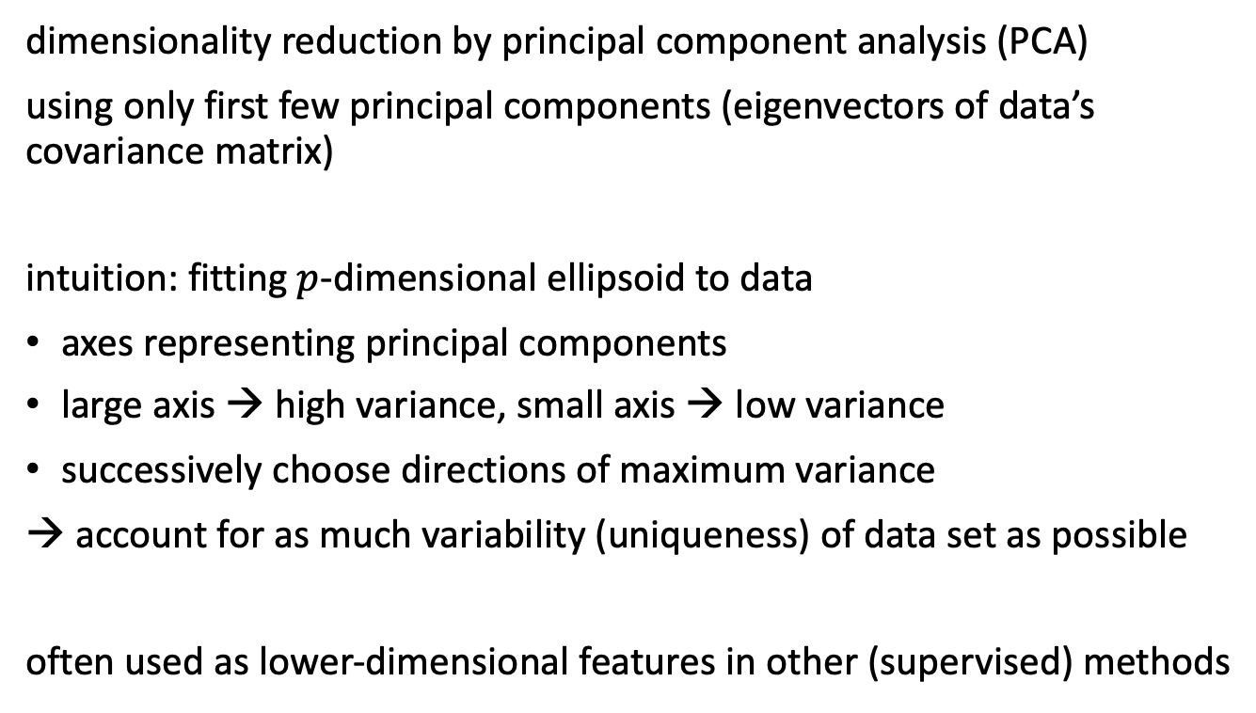
Example for Unsupervised Learning
dimensionality reduction by principal component analysis (PCA)
using only first few principal components (eigenvectors of data’s covariance matrix)
intuition: fitting $p$-dimensional ellipsoid to data
axes representing principal components
large axis → high variance, small axis → low variance
successively choose directions of maximum variance
→ account for as much variability (uniqueness) of data set as possible
often used as lower-dimensional features in other (supervised) methods
from wikipedia

Slide 21
Fitting / Statistical Learning

Slide 22
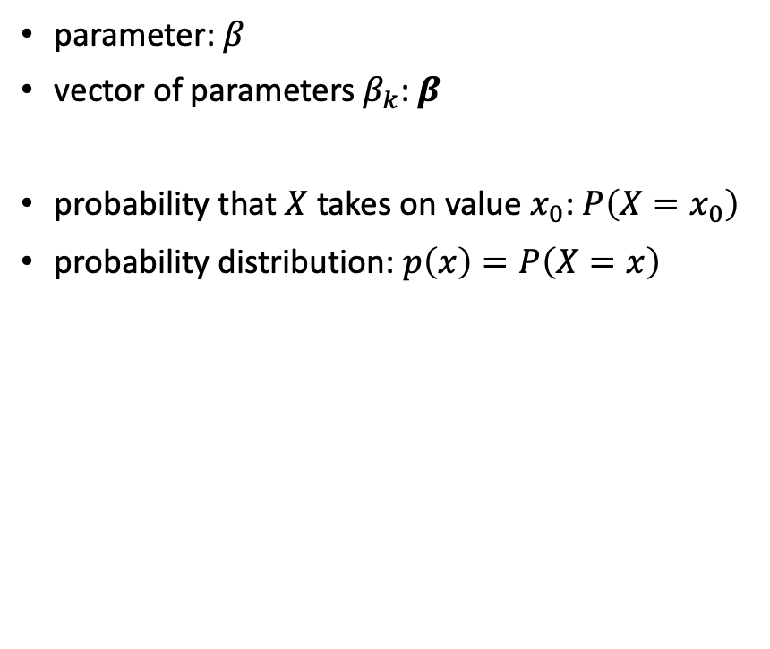
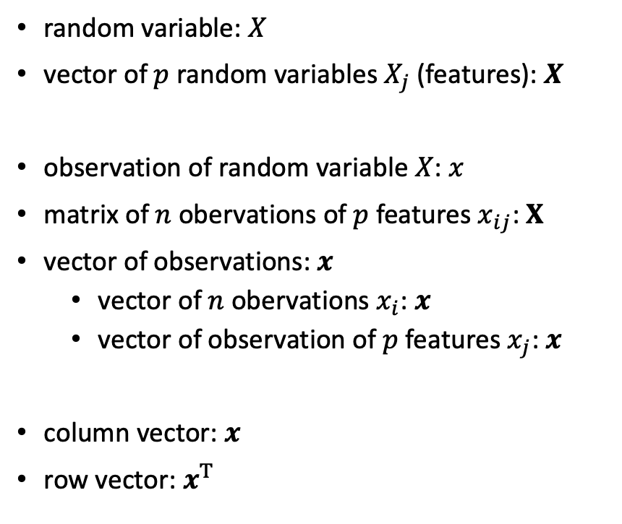
Notation
random variable: $X$
vector of $p$ random variables $X_{j}$ (features): $X$
observation of random variable $X$: $x$
matrix of $n$ obervations of $p$ features $x_{ij}$: $X$
vector of observations: $x$
vector of $n$ obervations $x_{i}$: $x$
vector of observation of $p$ features $x_{j}$: $x$
column vector: $x$
row vector: $x^{T}$
parameter: $β$
vector of parameters $β_{k}$: $β$
probability that $X$ takes on value $x_{0}$: $P\left(X=x_{0}\right)$
probability distribution: $p\left(x\right)=P\left(X=x\right)$
design matrix

Slide 23

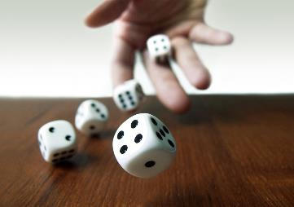
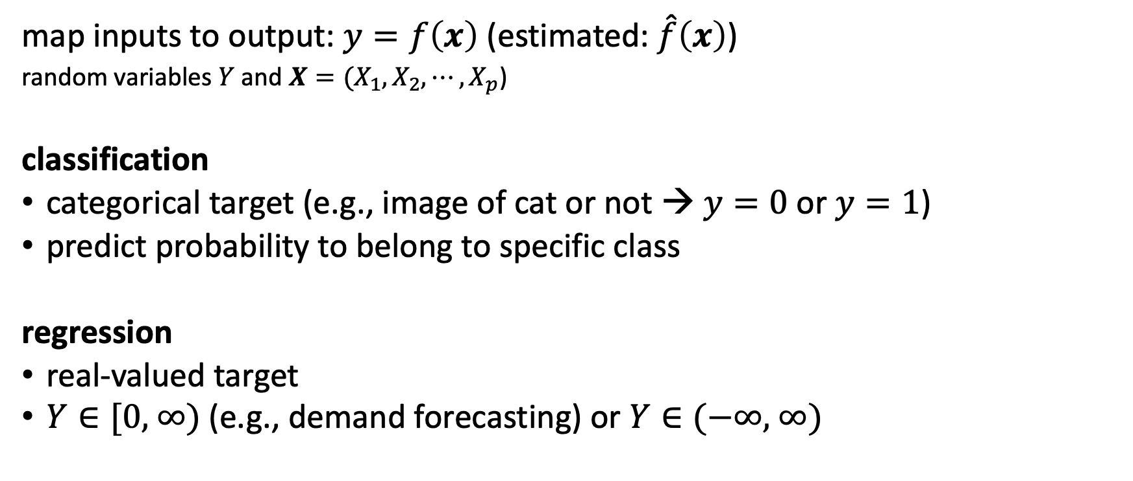
Supervised Learning Scenario
… ML …
map inputs to output: $y=f\left(x\right)$ (estimated: $\hat{f}\left(x\right)$)
random variables $Y$ and $X={(X}_{1}, X_{2},{⋯,X}_{p}$)
classification
categorical target (e.g., image of cat or not → $y=0$or $y=1$)
predict probability to belong to specific class
regression
real-valued target
$Y∈\text{[0, ∞)}$ (e.g., demand forecasting) or $Y∈\text{(−∞, ∞)}$
ML domain:
no deterministic dependencies between input and output

Slide 24
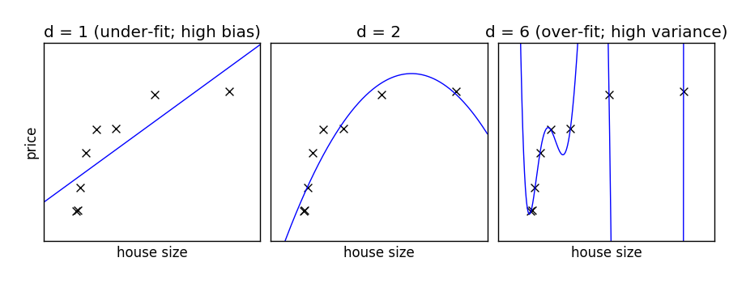
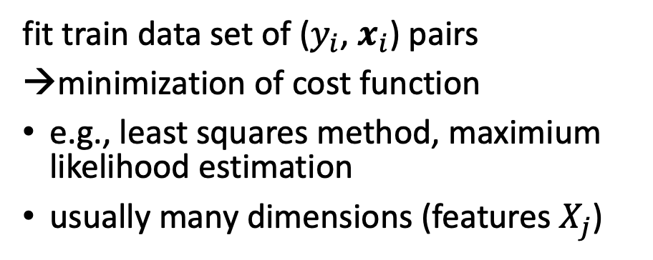
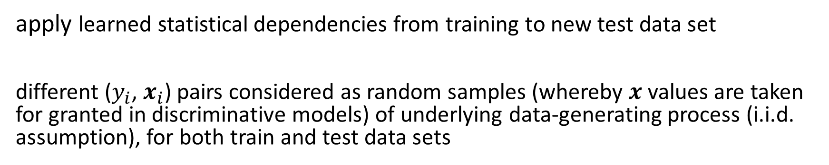
Curve Fitting / Parameter Estimation
d: degree of fitted polynomial → number of parameters
fit train data set of ($y_{i}$, $x_{i}$) pairs
minimization of cost function
e.g., least squares method, maximium likelihood estimation
usually many dimensions (features $X_{j}$)
from scikit-learn documentation
apply learned statistical dependencies from training to new test data set
different ($y_{i}$, $x_{i}$) pairs considered as random samples (whereby $x$ values are taken for granted in discriminative models) of underlying data-generating process (i.i.d. assumption), for both train and test data sets

Slide 25
Generalization
generalization as core of ML:
empirical risk minimization (training error) as proxy for minimizing unknown population risk (test error, aka generalization error or out-of-sample error)
generalization gap: difference between test and training error
interpolation to unencountered samples from training environment
extrapolation to testing conditions differing from training environment (aka out-of-distribution)
curse of dimensionality: many features (dimensions) → lots of data needed to densely sample volume
but reality is friendly: most high-dimensional data sets reside on lower-dimensional manifolds (manifold hypothesis) → enabling effectiveness of ML
→ need for appropriate inductive bias (different forms: model design, regularization, …)

Slide 26
Generalized Linear Models (GLM)

Slide 27

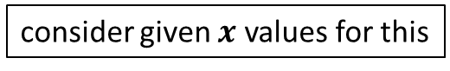
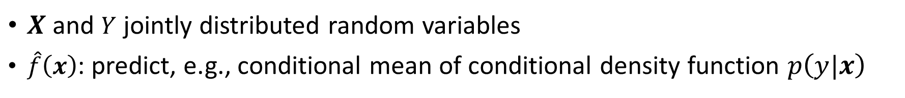
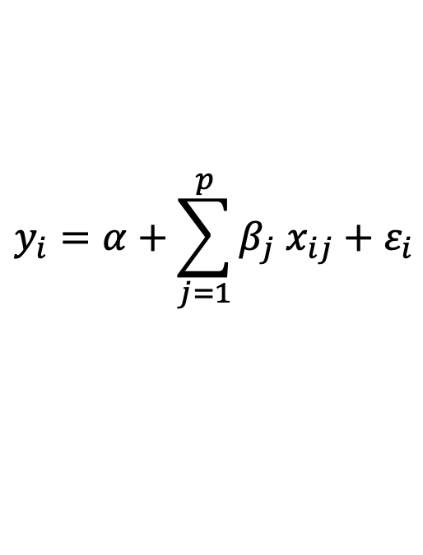
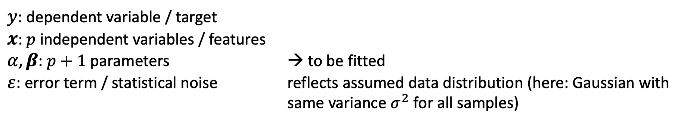
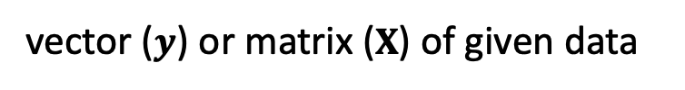
Linear Regression
$$y_{i}=α+\sum_{j=1}^{p}{β_{j} x_{ij}}+ε_{i}$$
(model)
}
from wikipedia
$y$: dependent variable / target
$x$: $p$ independent variables / features
$α,β$: $p+1$ parameters → to be fitted
$ε$: error term / statistical noise reflects assumed data distribution (here: Gaussian with same variance $σ^{2}$ for all samples)
vector ($y$) or matrix ($X$) of given data
consider given $x$ values for this
$X$ and $Y$ jointly distributed random variables
$\hat{f}\left(x\right)$: predict, e.g., conditional mean of conditional density function $p\left(y|x\right)$
depending on used loss function
(conditional mean for squared loss of least squares method)

Slide 28
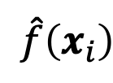
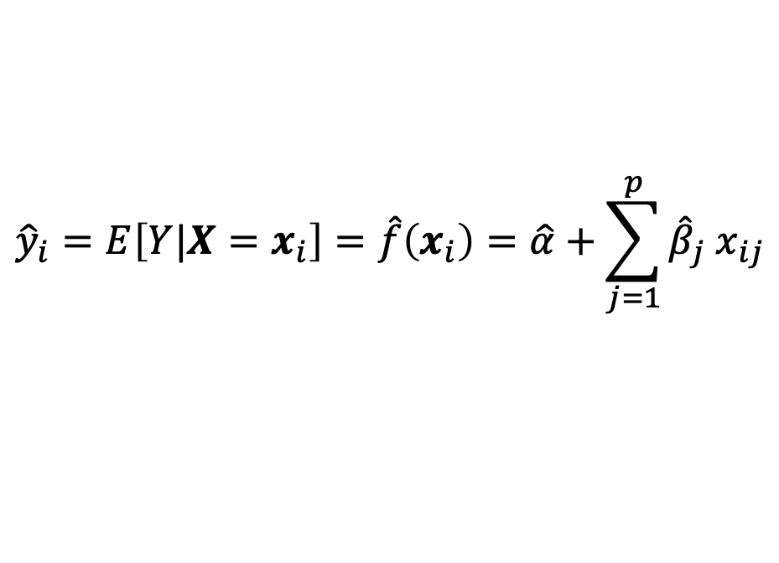
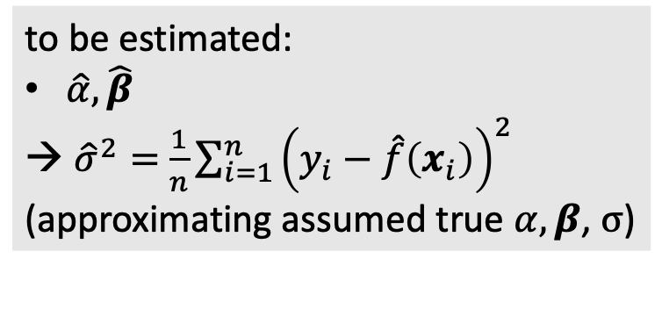
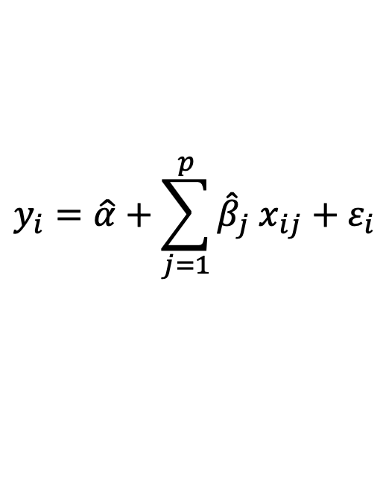
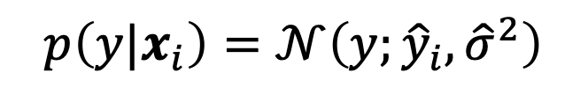
Linear Regression
$$\hat{f}\left(x_{i}\right)$$
fit:
to be estimated:
$\hat{α},\hat{β}$
${\hat{σ}}^{2}=$ $\frac{1}{n}\sum_{i=1}^{n}{{\left(y_{i}−\hat{f}\left(x_{i}\right)\right)}^{2}}$
(approximating assumed true $α, β$, $σ$)
$$y_{i}=\hat{α}+\sum_{j=1}^{p}{{\hat{β}}_{j} x_{ij}}+ε_{i}$$
Gaussian
predict:
$${\hat{y}}_{i}=E\left[Y|X=x_{i}\right]=\hat{f}\left(x_{i}\right)=\hat{α}+\sum_{j=1}^{p}{{\hat{β}}_{j} x_{ij}}$$
$$p\left(y|x_{i}\right)=𝒩\left(y;{\hat{y}}_{i}, {\hat{σ}}^{2}\right)$$
Gaussian
mean
variance

Slide 29
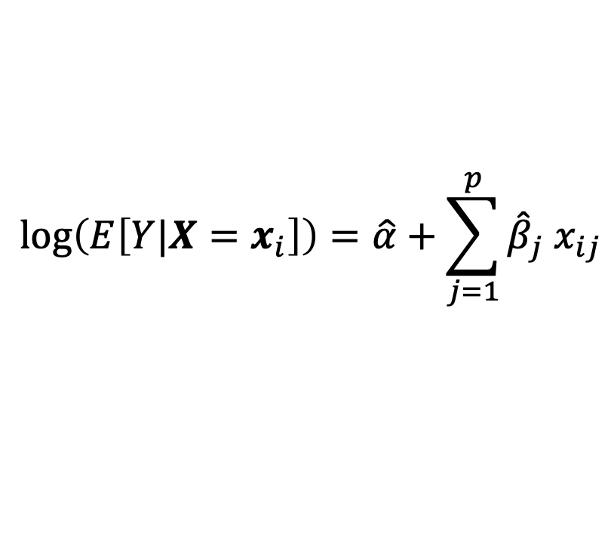
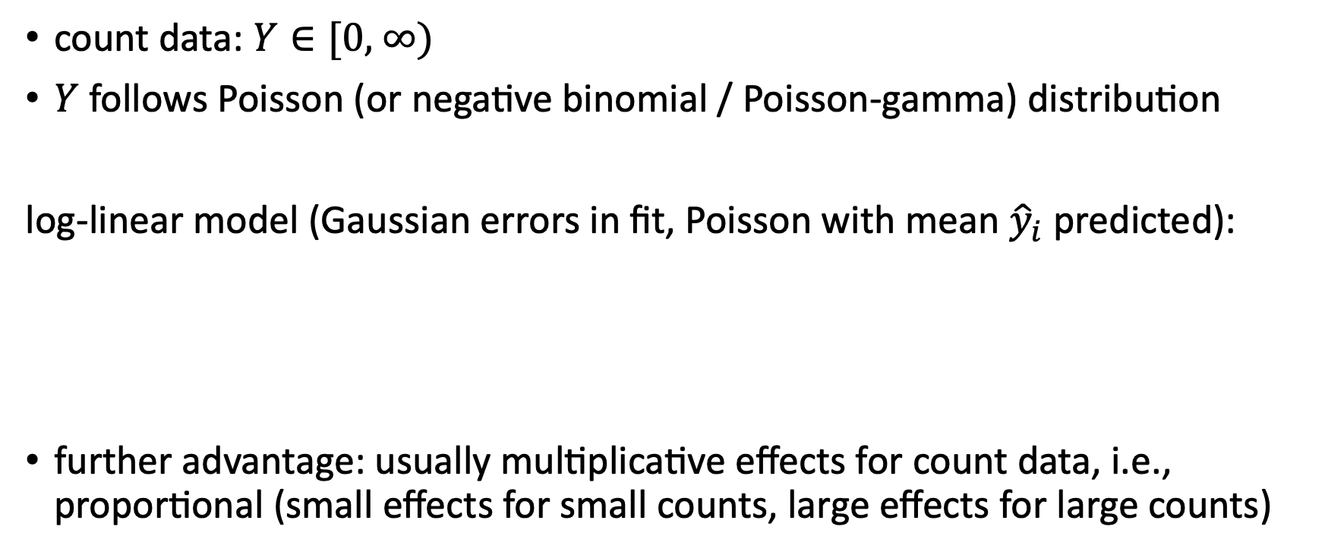
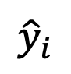
Multiplicative Model
count data: $Y∈\text{[0, ∞)}$
$Y$ follows Poisson (or negative binomial / Poisson-gamma) distribution
log-linear model (Gaussian errors in fit, Poisson with mean ${\hat{y}}_{i}$ predicted):
further advantage: usually multiplicative effects for count data, i.e., proportional (small effects for small counts, large effects for large counts)
$$\log\left(E\left[Y|X=x_{i}\right]\right)=\hat{α}+\sum_{j=1}^{p}{{\hat{β}}_{j} x_{ij}}$$
single parameter
$${\hat{y}}_{i}$$

Slide 30
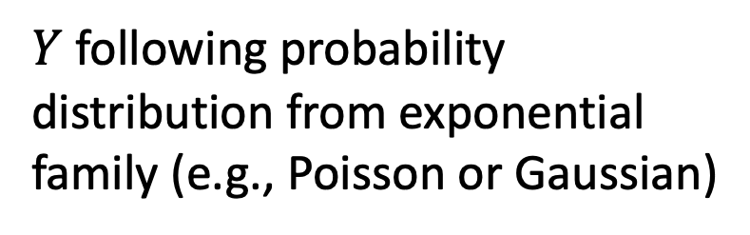
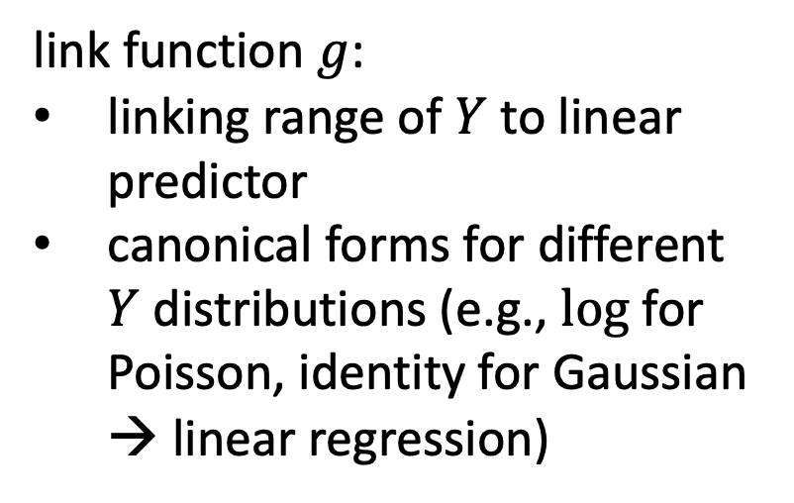
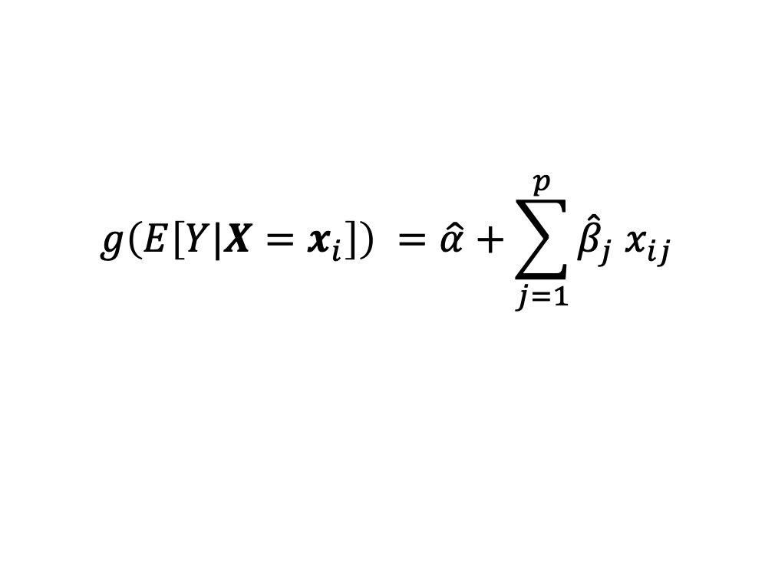
Scheme of GLMs
$$g\left(E\left[Y|X=x_{i}\right]\right) =\hat{α}+\sum_{j=1}^{p}{{\hat{β}}_{j} x_{ij}}$$
link function $g$:
linking range of $Y$ to linear predictor
canonical forms for different $Y$ distributions (e.g., log for Poisson, identity for Gaussian → linear regression)
$Y$ following probability distribution from exponential family (e.g., Poisson or Gaussian)

Slide 31
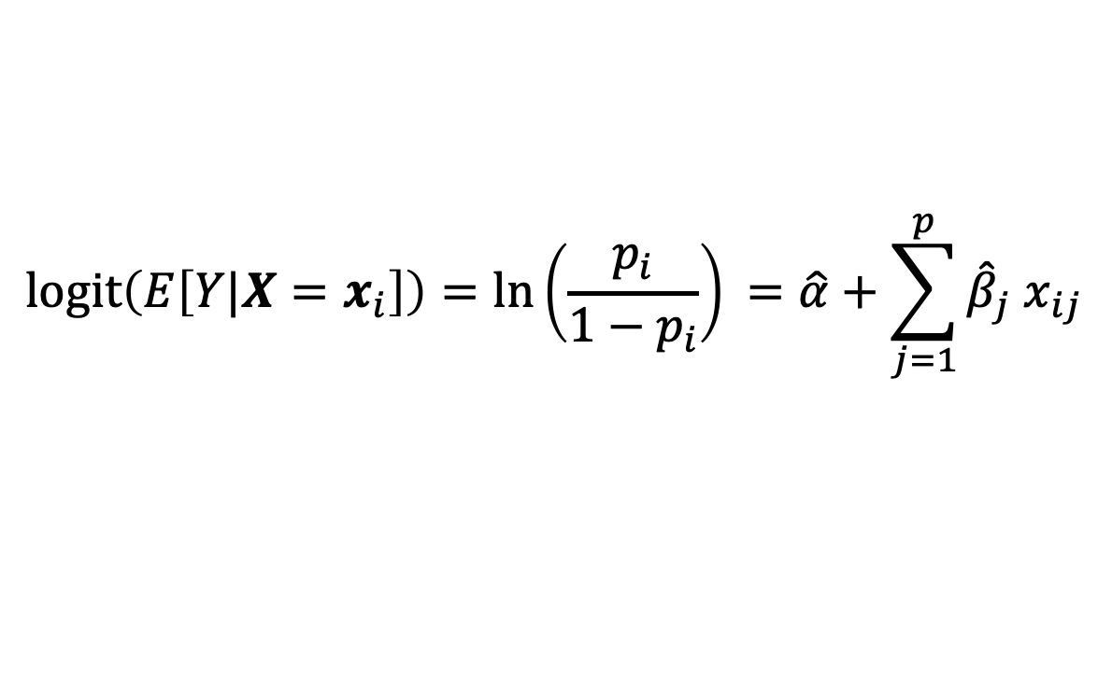
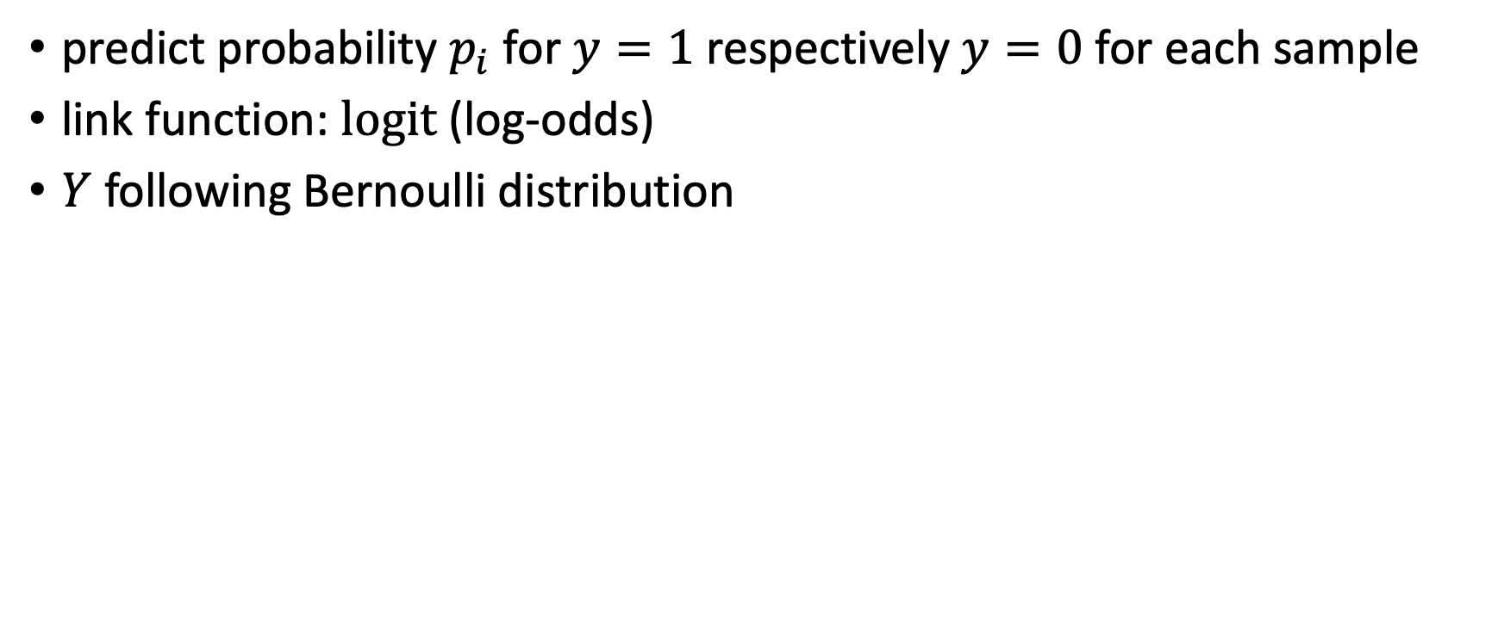
Classification: Logistic Regression
predict probability $p_{i}$ for $y=1$ respectively $y=0$ for each sample
link function: logit (log-odds)
$Y$ following Bernoulli distribution
$$\operatorname{logit}\left(E\left[Y|X=x_{i}\right]\right)=\ln\left(\frac{p_{i}}{1−p_{i}}\right)⁡=\hat{α}+\sum_{j=1}^{p}{{\hat{β}}_{j} x_{ij}}$$

Slide 32
Toward Non-Linear Models

Slide 33
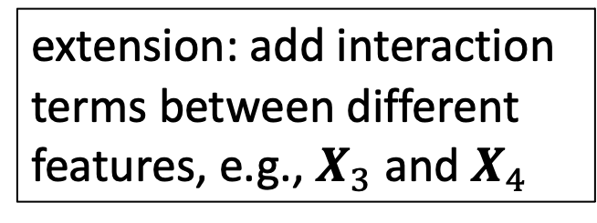
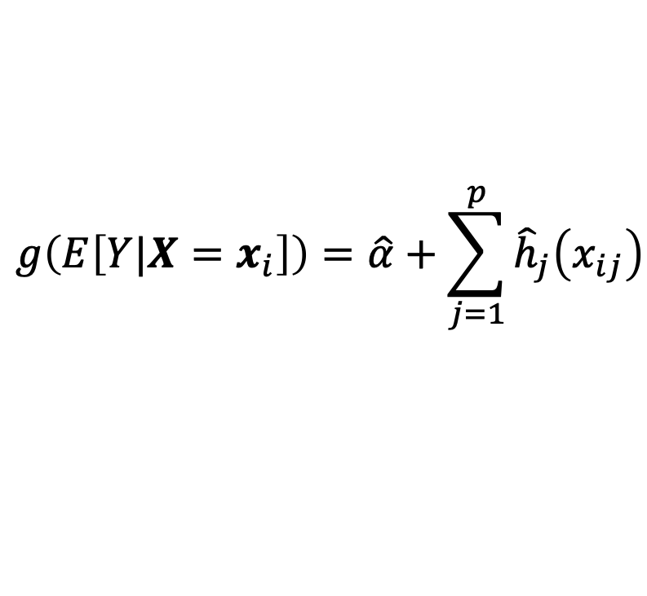
Generalized Additive Models (GAM)
blending of GLMs and additive models
$$g\left(E\left[Y|X=x_{i}\right]\right)=\hat{α}+\sum_{j=1}^{p}{{\hat{h}}_{j}\left(x_{ij}\right)}$$
extension: add interaction terms between different features, e.g., $X_{3}$ and $X_{4}$
smooth functions
potentially non-parametric form
describe non-linear effects
estimated, e.g., via backfitting algorithm
Cyclic Boosting

Slide 34

Algorithmic Families and Linear Building Blocks
linear (parametric) models
nearest neighbors (local methods, instance-based learning) – non-parametric models
decision trees: rule learning
linear regression
GLM
GAM
Day
Weekday
Weekend
neural networks: non-linear just by means of activation functions
3
Promo
No
Yes
demand prediction
5
8
often used in ensemble methods
bagging: random forests
boosting: gradient boosting
kernel/support-vector machines: linear model (maximum-margin hyperplane) with kernel trick
from wikipedia

Slide 35
At its heart, all the diverse statistical learning methods are reflections of the same underlying concept, and just differ in their applicability for different use cases.
(need to find method with best inductive bias for the task at hand → generalization capability)

Slide 36
ML Workflow

Slide 37
Modeling
execute hyperparameter tuning
extract features
choose ML algorithm
help the ML algorithm to better understand the data
impose assumptions hard to discover in the raw data
from open-source libraries like scikit-learn or pytorch, rarely write an own one
many different algorithms available, differently suited for given task
variety of different forms
model settings not all automatically adjusted by the machine

Slide 38
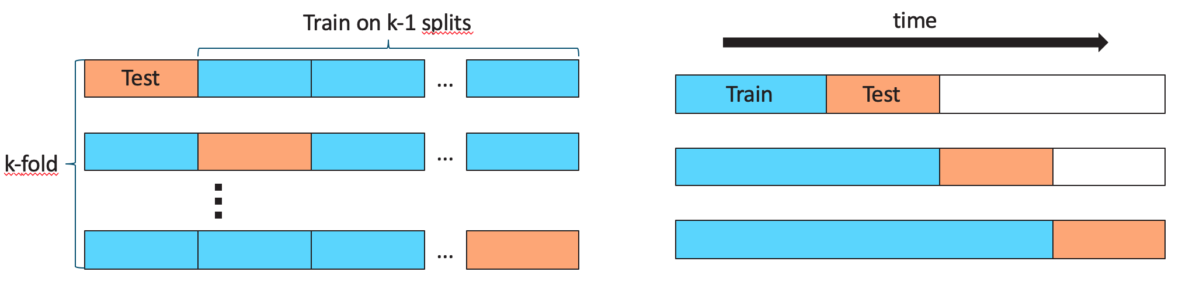
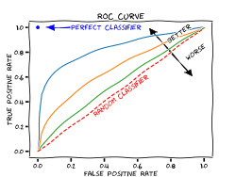
Evaluation
measure (out-of-sample) accuracy of predictions (loss function in training as proxy of this)
test structure
cross-validation
regression
point estimate: absolute (MAD, MSE, …) or relative (MAPE, …) metrics
full probability distribution: a bit tricky
classification
decide on acceptance of model changes by means of accuracy measure: improved model vs baseline (current best)
ROC curve (true and false positve rates)
from wikipedia

Slide 39
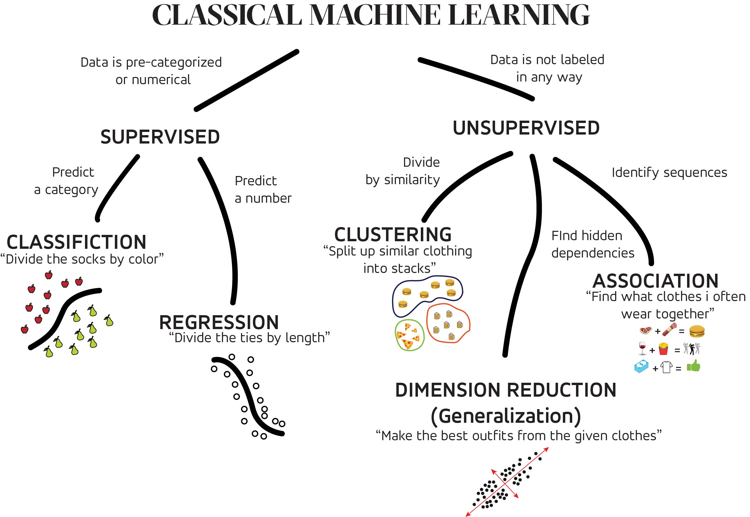
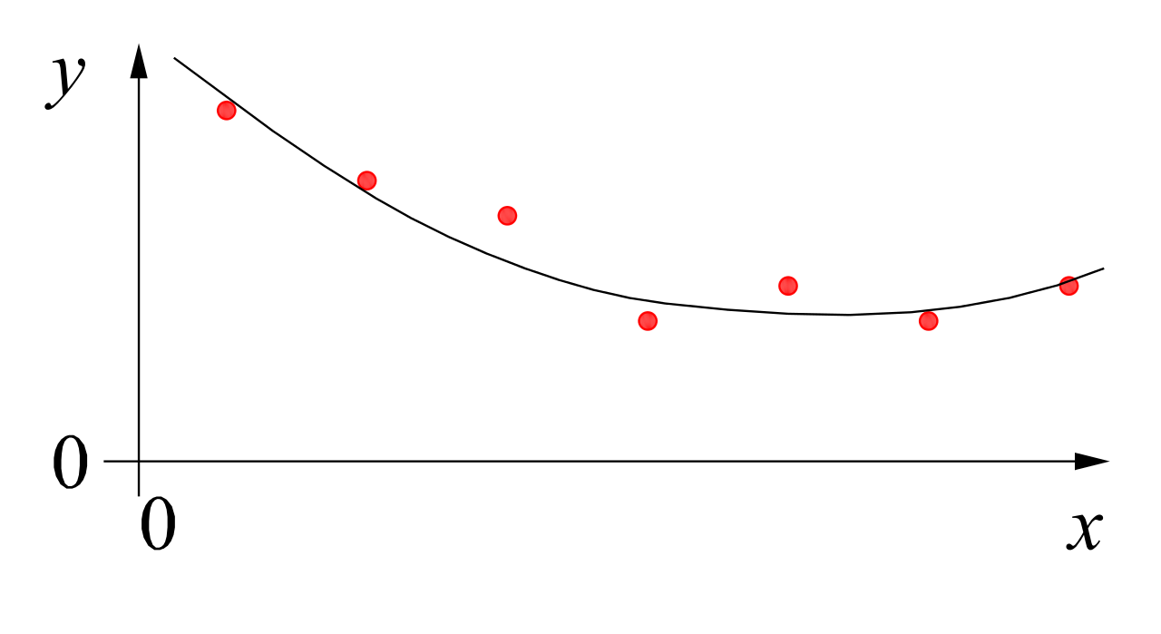


MACHINE LEARNING
no supervision, but goal-based interaction with environment
training target available (labeled or past data)
data not labeled in any way
REINFORCEMENT LEARNING
SUPERVISED
UNSUPERVISED
CLASSIFICATION
ASSOCIATION
CLUSTERING
LEARN STATE OR ACTION VALUES
LEARN POLICY DIRECTLY
REGRESSION
DIMENSIONALITY REDUCTION
GENERATIVE MODELS
learning by teacher
(high-dimensional curve fitting)
learning by observation
(pattern recognition)
learning by trial-and-error
(sequential decision making)
unsupervised and reinforcement learning can both be cast as supervised-learning setup

Slide 40
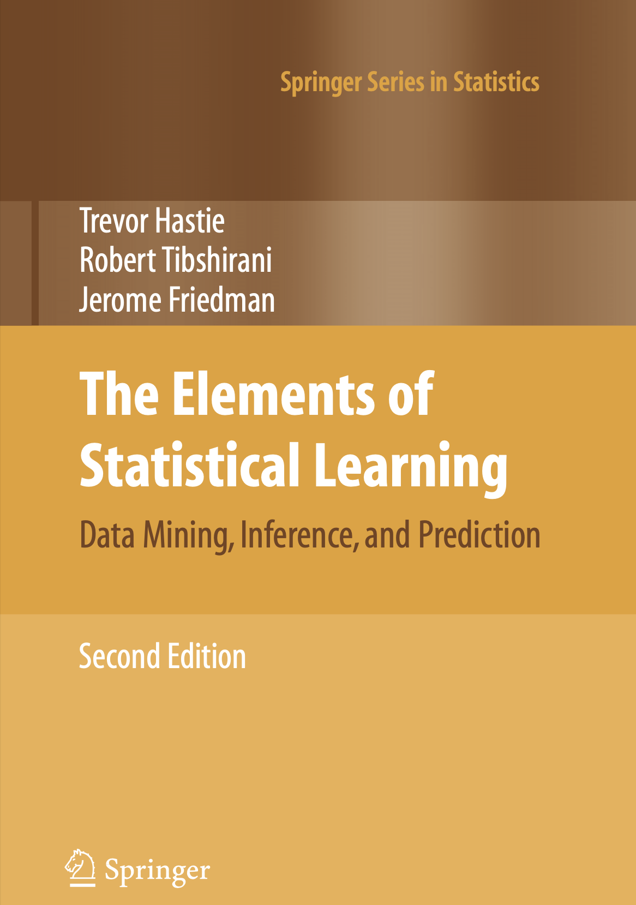
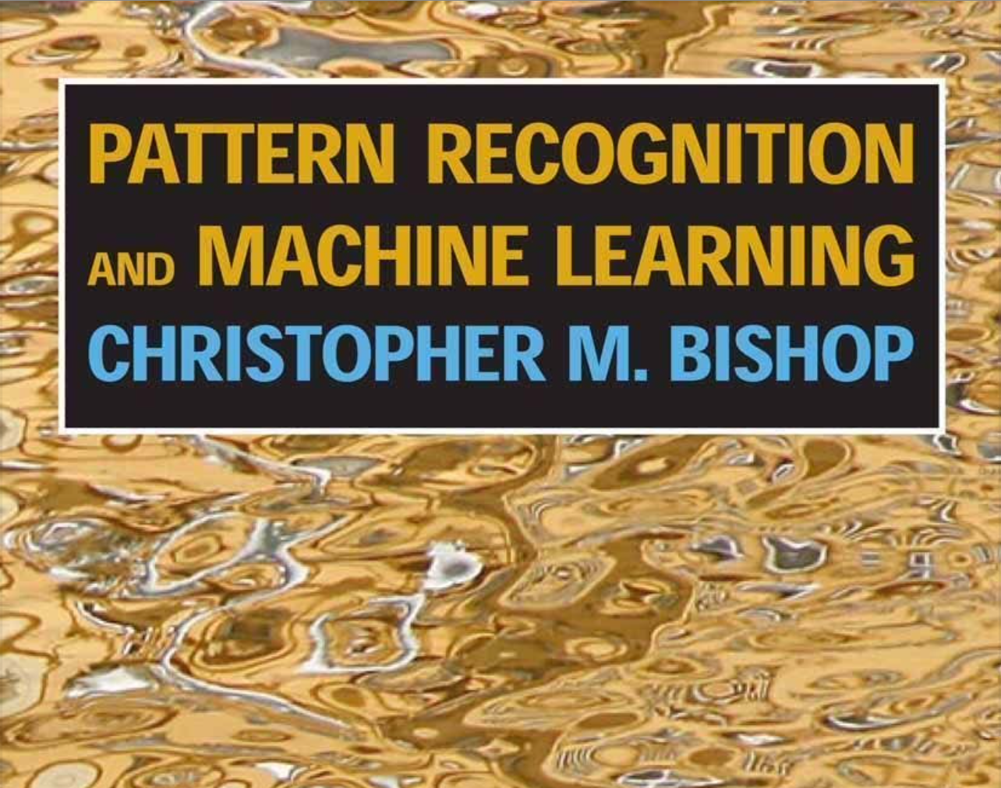
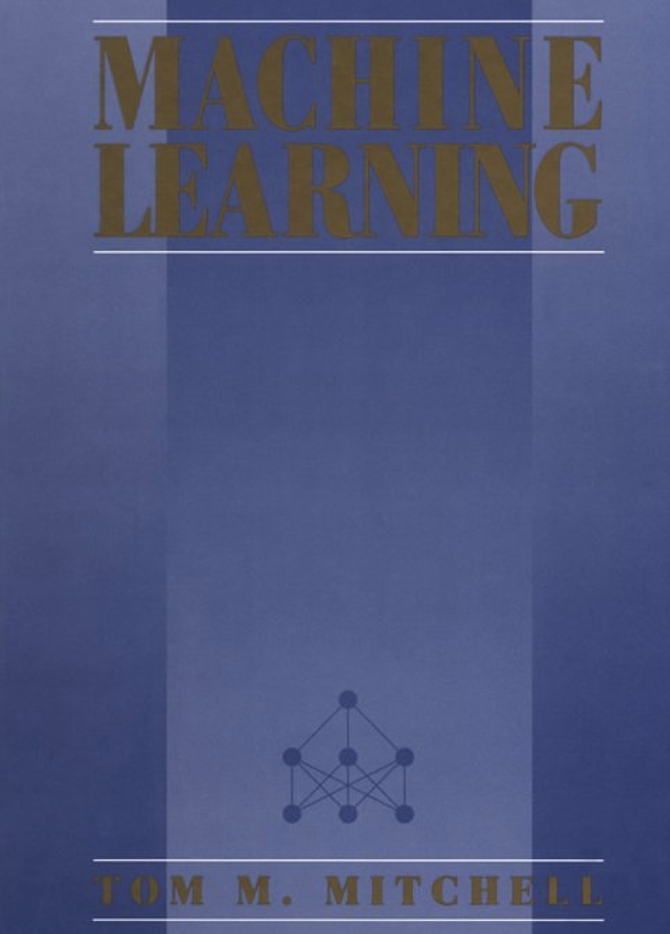
Literature
nice book on the foundations of ML (relevant for the whole course):
other general overviews:
Bishop
Mitchell
Hastie

Slide 41
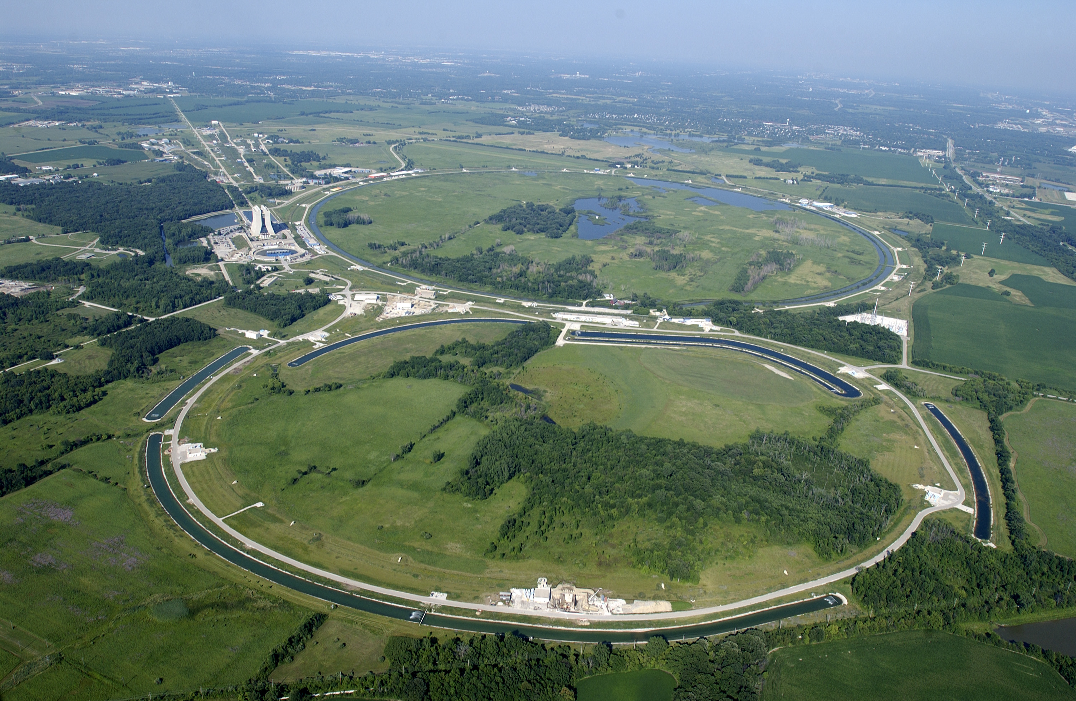
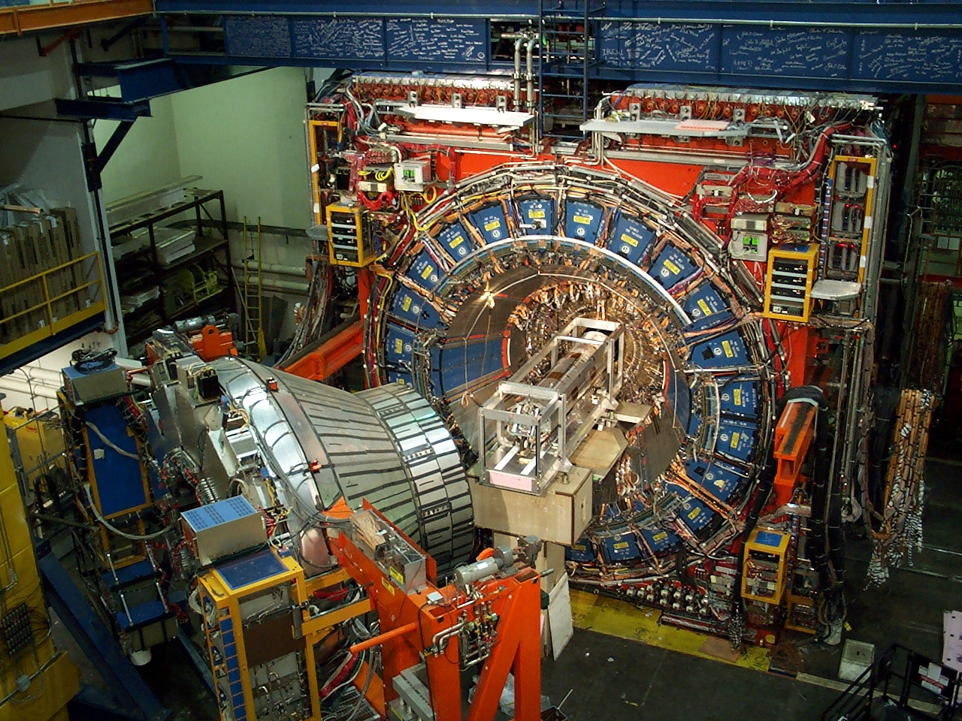

Scientific Application: ML in Particle Physics
https://arxiv.org/abs/1105.5995
https://arxiv.org/abs/1207.0825
example: classification of decay signatures in particle colliders
charmed baryon signals filtered out of background
Tevatron accelerator at Fermilab
CDF detector at Tevatron

